Slide 1
Spark 研習營
Yao-Chung Fan (范耀中)
yfan@nchu.edu.tw
Ubiquitous Data and Intelligent Computing Lab
普及資料與智慧運算實驗室
大數據創新應用人才培育基地@中興大學

Slide 2













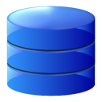
How much data today?
4.6 billion camera phones world wide
12+ TBs of tweet data every day
30 billion RFID tags today (1.3B in 2005)
100s of millions of GPS enabled devices sold annually
? TBs of data every day
640K ought to be enough for anybody.
25+ TBs of log data every day
76 million smart meters in 2009… 200M by 2014
2+ billion people on the Web by end 2011
0110100010010001000101001111001000110101101000100100010001010011110010001001000100100011001000100100010010001010001001000
Notes:
2

Slide 3


Slide 4








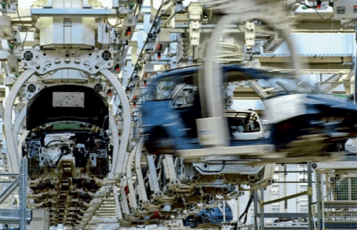



Applications for Big Data Analytics
Smarter Healthcare
Multi-channel sales
Finance
Log Analysis
Homeland Security
Traffic Control
Telecom
Search Quality
Manufacturing
Trading Analytics
Fraud and Risk
Retail: Churn, NBO

Slide 5
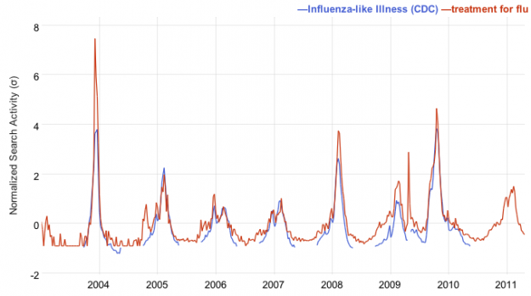


The power of data Google 預測感冒大流行?
Ginsberg et al. (Nature 2009) used Google web search queries that correlate with an influenza epidemic, such as “flu”, “fever”.

Slide 6
The power of data
Answering factoid questions
Pattern matching on the Web
Works amazingly well than the best algorithms
Who shot Abraham Lincoln? → X shot Abraham Lincoln
問答系統（英語：Question answering），是未來自然語言處理的明日之星。問答系統外部的行為上來看，其與目前主流資訊檢索技術有兩點不同：首先是查詢方式為完整而口語化的問句，再來則是其回傳的為高精準度網頁結果或明確的答案字串。以Ask Jeeves為例，使用者不需要思考該使用甚麼樣的問法才能夠得到理想的答案，只需要用口語化的方式直接提問如「請問誰是美國總統？」即可。而系統在瞭解使用者問句後，會非常清楚地回答「歐巴馬是美國總統」。面對這種系統，使用者不需要費心去一一檢視搜尋引擎回傳的網頁，對於資訊檢索的效率與資訊的普及都有很大幫助。從系統內部來看，問答系統使用了大量有別於傳統資訊檢索系統自然語言處理技術，如自然語言剖析（Natural Language Parsing）、問題分類（Question Classification）、專名辨識（Named Entity Recognition）等等。少數系統[1]甚至會使用複雜的邏輯推理機制，來區隔出需要推理機制才能夠區隔出來的答案。在系統所使用的資料上，除了傳統資訊檢索會使用到的資料外（如字典），問答系統還會使用本體論等語義資料，或者利用網頁來增加資料的豐富性。截至目前為止，最著名的問答系統應屬IBM的華生系統。該系統在2011年於Jeopardy節目中，與人類同場較勁，並獲得最後的勝利。

Slide 7




Available data

Slide 8
Now you realize the the power of data.

Slide 9

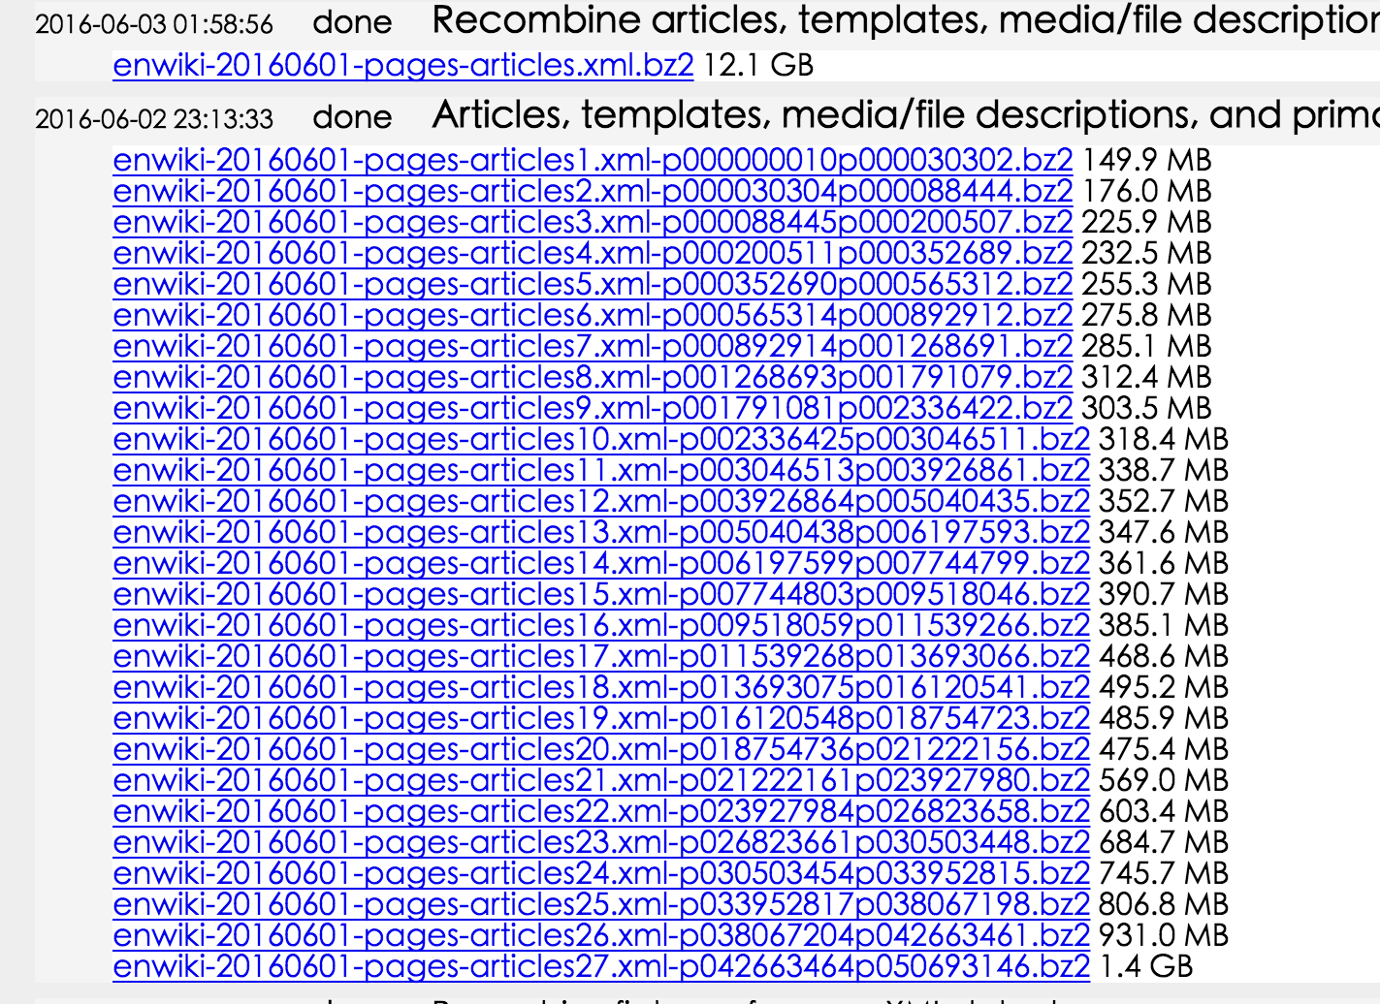
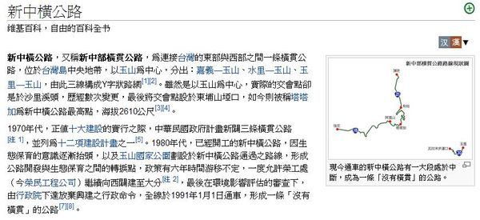
Wiki Articles
English wiki dump 2016/06/01
https://dumps.wikimedia.org/enwiki/20160501/

Slide 10
Hello !!!!
請告訴我英文文集中，出現頻率最高的前十個單字

Slide 11
Wiki Articles
English wiki dump 2016/06/01
https://dumps.wikimedia.org/enwiki/20160501/
5,174,418 million articles
29,000,000,000 words !!!!!!!

Slide 13
想想辦法吧？

Slide 14
Divide and Conquer !!!!!!!!
200G
200G
200G
200G
200G
1TB

Slide 15
Current Tools
Parallel Programming models
Shared memory (Java Threads)
Message passing interface (MPI)
Message Passing
Shared Memory
Memory
P₁
P₂
P₃
P₄
P₅
P₁
P₂
P₃
P₄
P₅

Slide 16
Managing Multiple Workers
Difficult because
We don’t know the order in which workers run
We don’t know when workers interrupt each other
We don’t know the order in which workers access shared data
Thus, we need:
Semaphores (lock, unlock)
Conditional variables (wait, notify, broadcast)
Still, lots of problems:
Deadlock, livelock, …

Slide 17
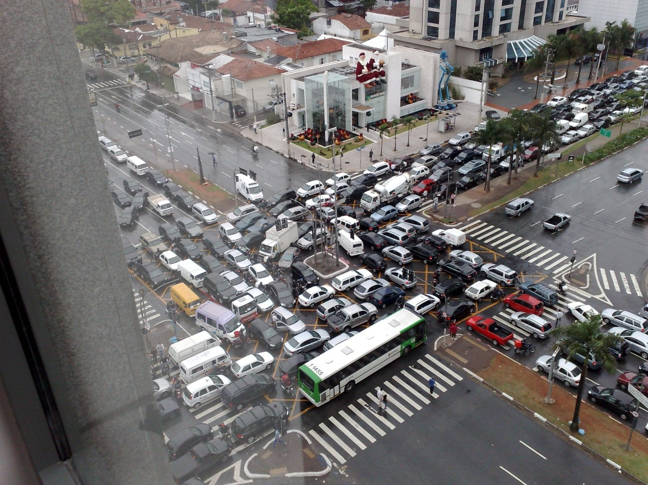
Source: Ricardo Guimarães Herrmann

Slide 19

MapReduce

Slide 20
What’s the point?
Hide system-level details from the developers
Using Commodity Machines to Scale up the power !

Slide 21
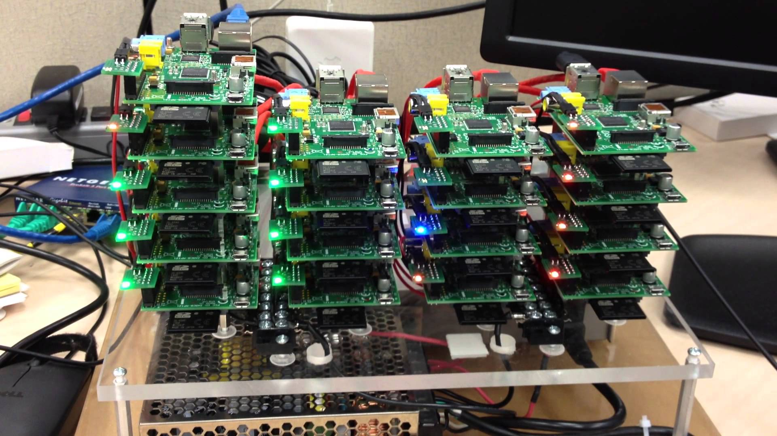

Slide 22
Hadoop Cluster

Slide 23
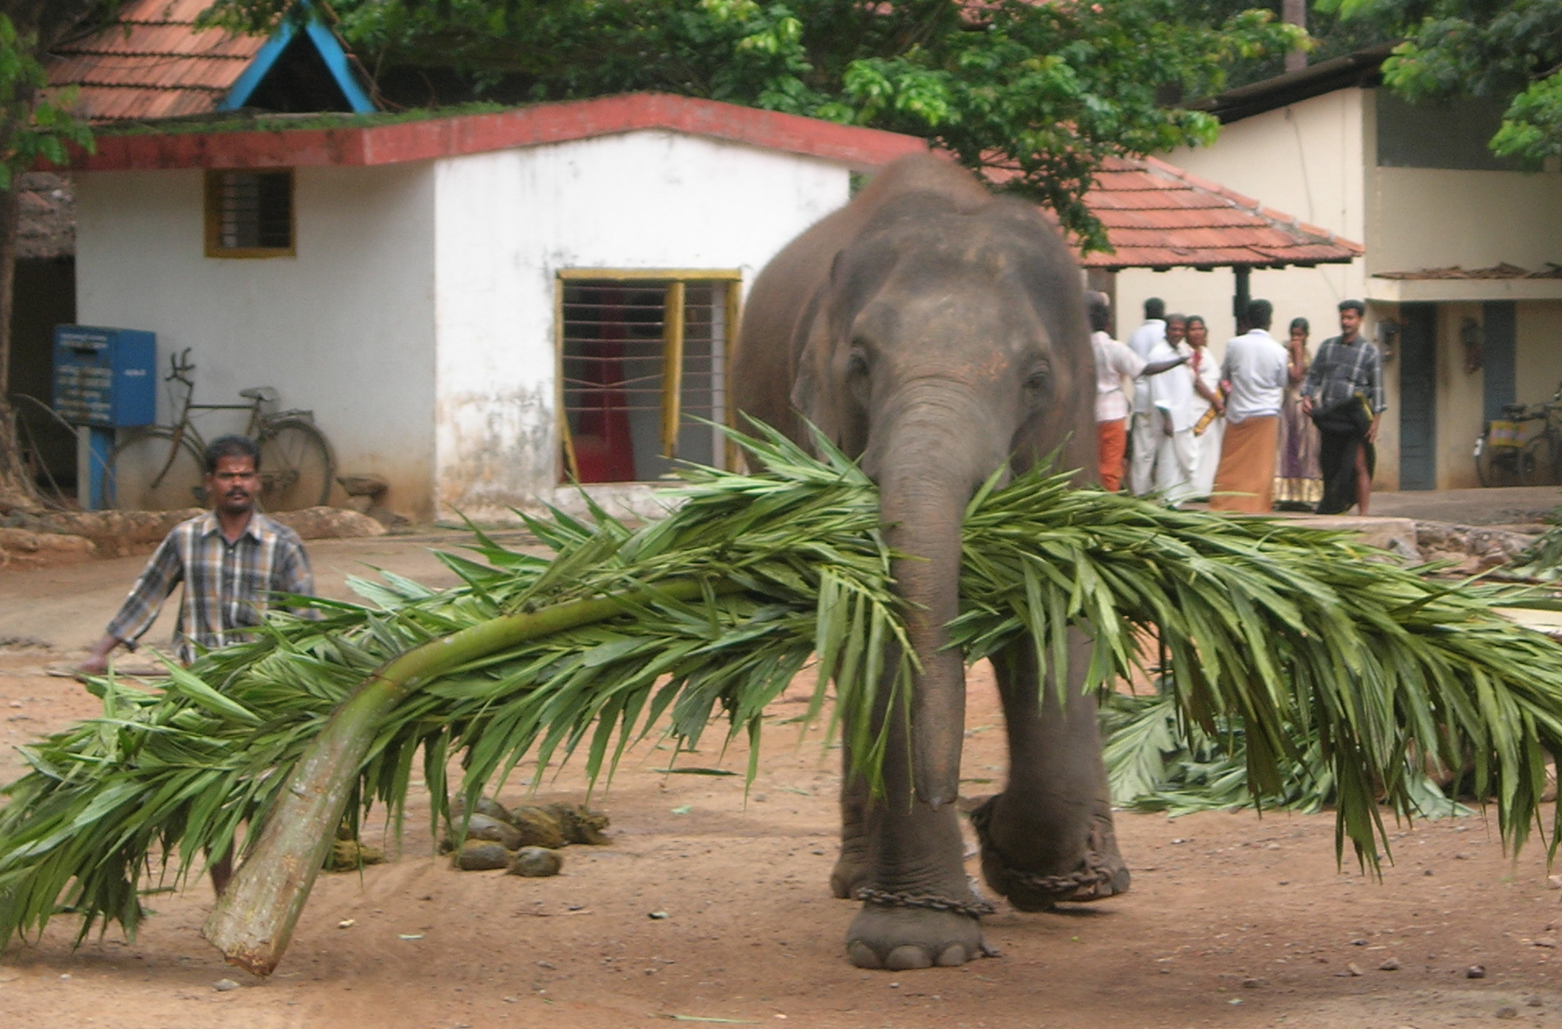
MapReduce
Source: Wikipedia (Mahout)

Slide 24
What is MapReduce?
Parallel programming model for clusters of commodity machines
Platform for reliable, scalable parallel computing
Abstracts issues of parallel environment from programmer.

Slide 25
A short history
Google’s GFS & MapReduce papers published:
SOSP 2003 : “The Google File System”
OSDI 2004 : “MapReduce : Simplifed Data Processing on Large Cluster”
OSDI 2006 : “Bigtable: A Distributed Storage System for Structured Data”
http://research.google.com/pubs/papers.html

Slide 26
MapReduce Implementations
Google has a proprietary implementation in C++
Bindings in Java, Python
Hadoop is an open-source implementation in Java
Development led by Yahoo, used in production
Now an Apache project
Rapidly expanding software ecosystem

Slide 27
Introduction to Hadoop
Apache Hadoop
Open Source – Apache Foundation project
Apache Platinum Sponsor
History
Started in 2005 by Doug Cutting
Yahoo! became the primary contributor in 2006
Portable
Written in Java
Runs on commodity hardware
Linux, Mac OS/X, Windows, and Solaris

Slide 28


A short history
Dong Cutting
Hired by Yahoo at 2006
Hadoop

Slide 29


Growing Hadoop Ecosystem
Hadoop Core
Distributed File System
MapReduce Framework
Pig (initiated by Yahoo!)
Parallel Programming Language and Runtime
Hbase (initiated by Powerset)
Table storage for semi-structured data
Zookeeper (initiated by Yahoo!)
Coordinating distributed systems
Hive (initiated by Facebook)
SQL-like query language and metastore

Slide 31
1. MapReduce Key-Value Programming Model
2. MapReduce Key-Value Programming Model
3. MapReduce Key-Value Programming Model

Slide 32
MapReduce Programming Model
You write two functions, Map and Reduce.
They each have a special form (key-value pairs).

Slide 33
MapReduce Programming Model
Data type: key-value records
Map function:
(K_{in}, V_{in}) ➔ list(K_{inter}, V_{inter})
Reduce function:
(K_{inter}, list(V_{inter})) ➔ list(K_{out}, V_{out})
All values with the same key are sent to the same reducer

Slide 34
The WordCount

Slide 35
MapReduce Programming Model: Word Count
Map(String docid, String text):
for each word w in text:
Emit(w, 1);
Reduce(String term, Iterator<Int> values):
int sum = 0;
for each v in values:
sum += v;
Emit(term, value);

Slide 36
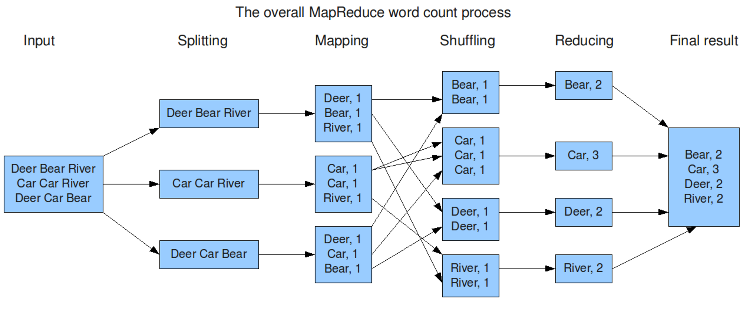
Word Count Example
As a programmer, you just only to focus ….

Slide 37
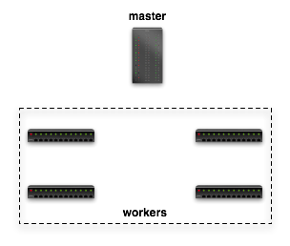

Dataflow in Hadoop
Submit job
map
schedule
reduce
map
reduce

Slide 38
Dataflow in Hadoop
Read
Input File
map
reduce
Block 1
HDFS
Block 2
map
reduce

Slide 39
Dataflow in Hadoop
map
Local FS
reduce
map
Local FS
reduce

Slide 40
Dataflow in Hadoop
Write Final Answer
reduce
HDFS
reduce

Slide 41
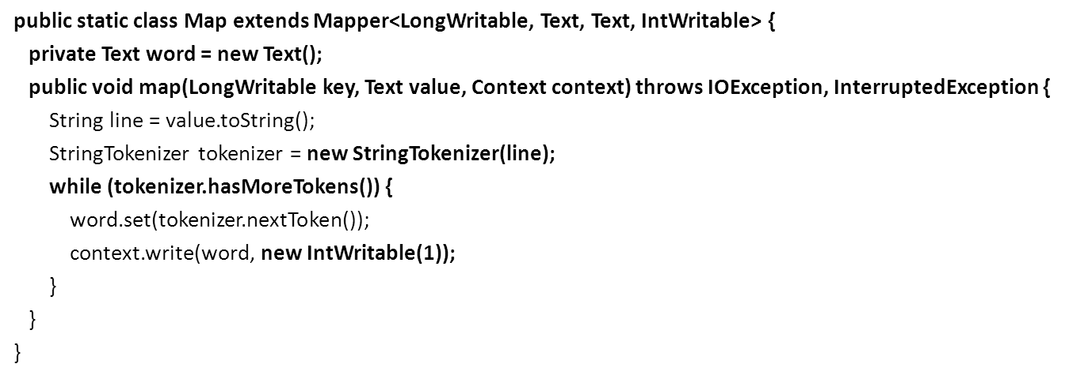
Test.txt
Parallel Programming
What is your name?
What is your name?
My name is Mickey
Hello Mickey
Hello Mickey
Hello Hello Hello
Parallel Programming
word.set(“Parallel”);
context.write(word, new intWritable(1));

Slide 42
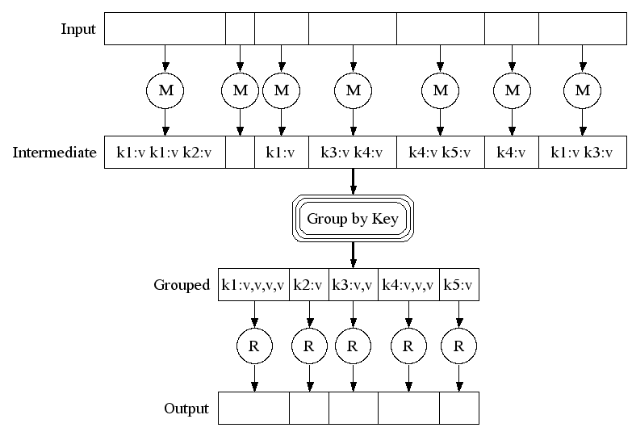
MapReduce Concept
Parallel Programming
What is your name?
What is your name?
My name is Mickey
Hello Mickey
Hello Mickey
Hello Hello Hello
(Hello,1)
(Hello,1)
(Hello,1)
(Hello,1)
(Hello,1)
Hello: 1, 1, 1, 1, 1
Mickey: 1, 1, 1
Parallel: 1

Slide 43
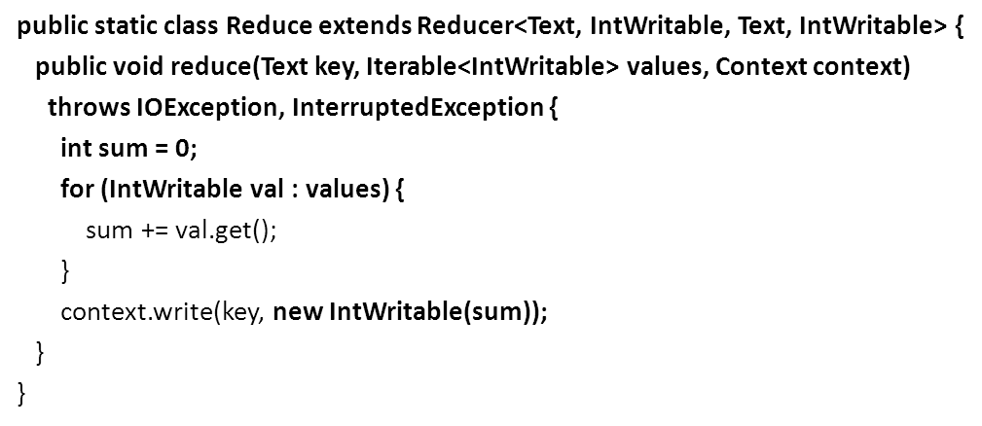
Hello: 1, 1, 1, 1, 1
Mickey: 1, 1, 1
Parallel: 1
Hello: 1, 1, 1, 1, 1
Key, Value List
1+1+1+1+1
Context.write(Hello, 5);

Slide 44
MapReduce Programming Model
Data type: key-value records
Map function:
(K_{in}, V_{in}) ➔ list(K_{inter}, V_{inter})
Reduce function:
(K_{inter}, list(V_{inter})) ➔ list(K_{out}, V_{out})

Slide 45
Please think about …
根據wordcount結果，按照出現次數進行排序。
Parallel Programming
What is your name?
What is your name?
My name is Mickey
Hello Mickey
Hello Mickey
Hello Hello Hello
Parallel 1
Programming 1
Name 3
Hello 5
Mickey 3
:
:
1 Parallel
1 Programming
3 Name
5 Hello
:
:
:

Slide 46
public static void main(String[] args) throws Exception {
Configuration conf = new Configuration();
Job job = new Job(conf, "wordcount");
job.setOutputKeyClass(Text.class);
job.setOutputValueClass(IntWritable.class);
job.setMapperClass(Map.class);
job.setReducerClass(Reduce.class);
job.setJarByClass(WordCount.class);
job.setInputFormatClass(TextInputFormat.class);
job.setOutputFormatClass(TextOutputFormat.class);
FileInputFormat.addInputPath(job, new Path(args[0]));
FileOutputFormat.setOutputPath(job, new Path(args[1]));
job.waitForCompletion(true); //工作執行！
}
Read
Input File
Write
Output File
Map
Reduce
k
k
k
k
HDFS
HDFS
v
v
v
v

Slide 47
Read
Input File
Write
Output File
Map
Reduce
k
k
k
k
HDFS
HDFS
v
v
v
v
Write
Output File
Reduce
Map
k
k
k
k
HDFS
v
v
v
v
Read
output File
Parallel Programming
What is your name?
What is your name?
My name is Mickey
Hello Mickey
Hello Mickey
Hello Hello Hello
Parallel 1
Programming 1
Name 3
Hello 5
Mickey 3
:
:
1 Parallel
1 Programming
3 Name
5 Hello
:
:
:

Slide 48
This assignment will let you know…
Iterative Programming Model

Slide 49

MapReduce
Why MapReduce is proposed ?
A simplified platform for programmer or scientists with non-parallel background
Hadoop: an open source implementation for MapReduce

Slide 50
Apache Hadoop – key components
Hadoop Common: Common utilities
(Storage Component) Hadoop Distributed File System (HDFS): A distributed file system that provides high-throughput access
(Scheduling) Hadoop YARN: A framework for job scheduling and cluster resource management
(Processing) Hadoop MapReduce (MR2): A YARN-based system for parallel processing of large data sets

Slide 51
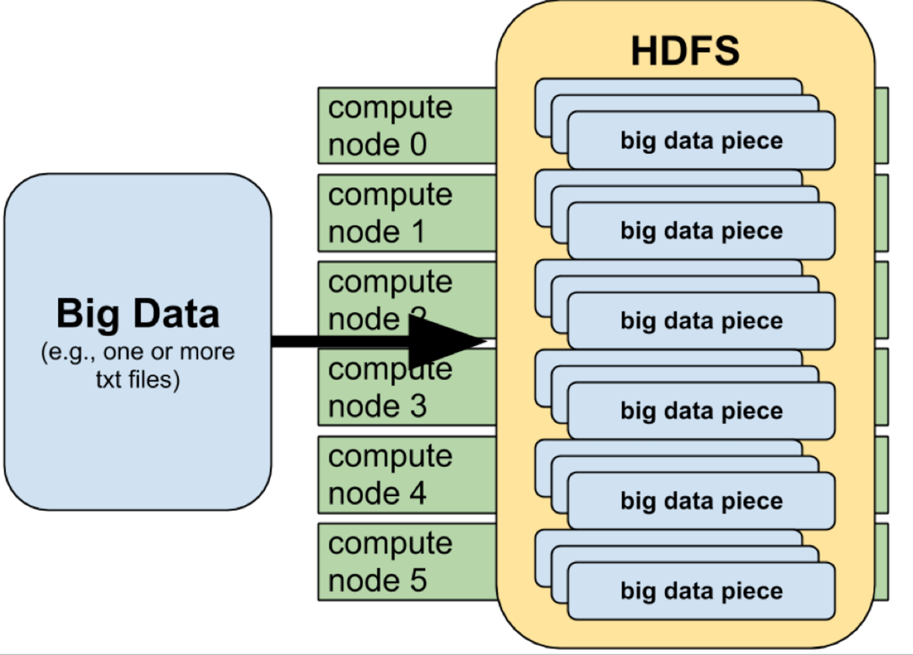
HDFS

Slide 52
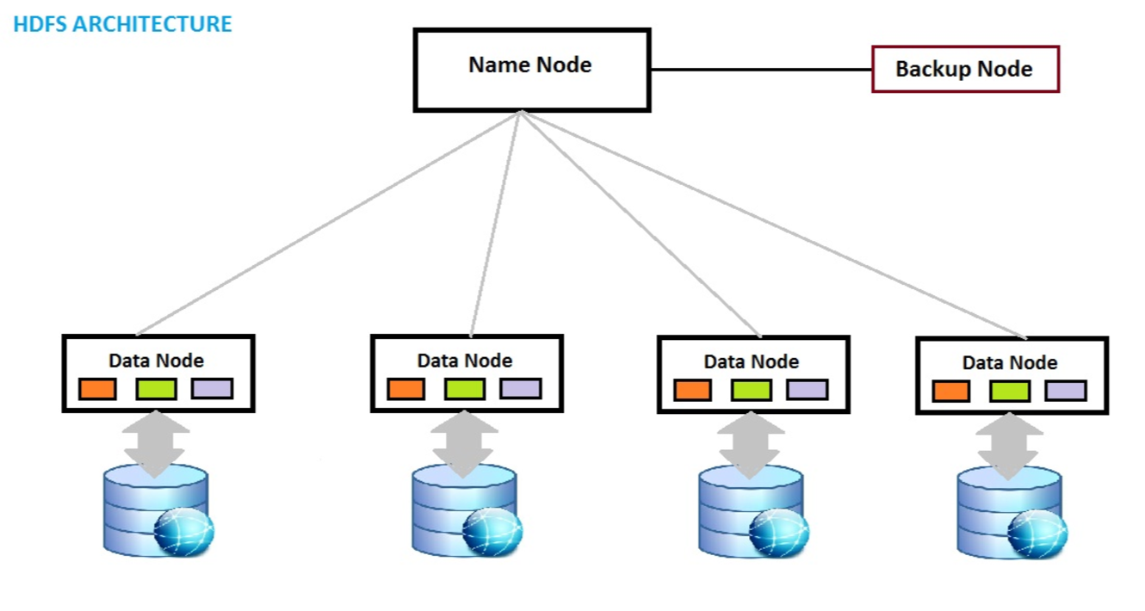
HDFS

Slide 53
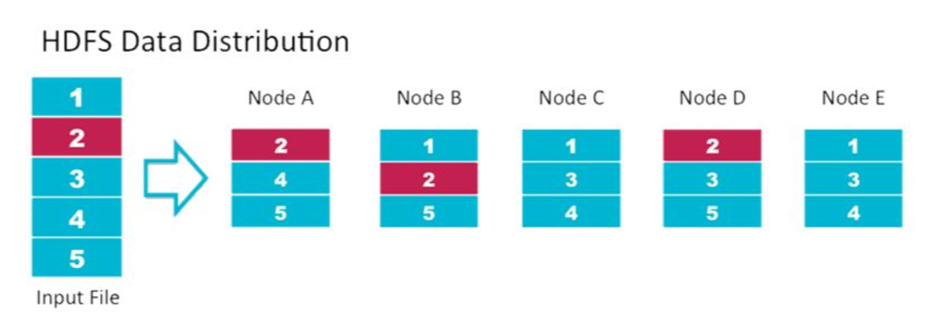
HDFS

Slide 54
MapReduce problems & potential solution
MapReduce problems:
Many problems aren’t easily described as map-reduce
Persistence to disk typically slower than in-memory work

Slide 55
Spark
“Resilient Distributed Datasets: A Fault-Tolerant Abstraction for In-Memory Cluster Computing” by Matei Zaharia et al
https://www.cs.berkeley.edu/~matei/papers/2012/nsdi_spark.pdf

Slide 56
Apache Spark
Processing engine; instead of just “map” and “reduce”, defines a large set of operations (transformations & actions)
In-memory Computation
Key construct: Resilient Distributed Dataset (RDD)

Slide 57
Gray sort competition: Winner Spark-based (previously MR)
 | Hadoop MR Record | Spark Record (2014)
Data Size | 102.5 TB | 100 TB
Elapsed Time | 72 mins | 23 mins
# Nodes | 2100 | 206
# Cores | 50400 physical | 6592 virtualized
Cluster disk throughput | 3150 GB/s (est.) | 618 GB/s
Network | dedicated data center, 10Gbps | virtualized (EC2) 10Gbps network
Sort rate | 1.42 TB/min | 4.27 TB/min
Sort rate/node | 0.67 GB/min | 20.7 GB/min
Spark-based
System
3x faster
with 1/10
# of nodes
Sort benchmark, Daytona Gray: sort of 100 TB of data (1 trillion records)

Slide 58
Spark vs. Hadoop MapReduce
Performance: Spark normally faster but with caveats
Spark can process data in-memory; Hadoop MapReduce persists back to the disk after a map or reduce action
Spark generally outperforms MapReduce, but it often needs lots of memory to do well; if there are other resource-demanding services or can’t fit in memory, Spark degrades
MapReduce easily runs alongside other services with minor performance differences, & works well with the 1-pass jobs it was designed for
Ease of use: Spark is easier to program
Data processing: Spark more general
Maturity: Spark maturing, Hadoop MapReduce mature

Slide 59
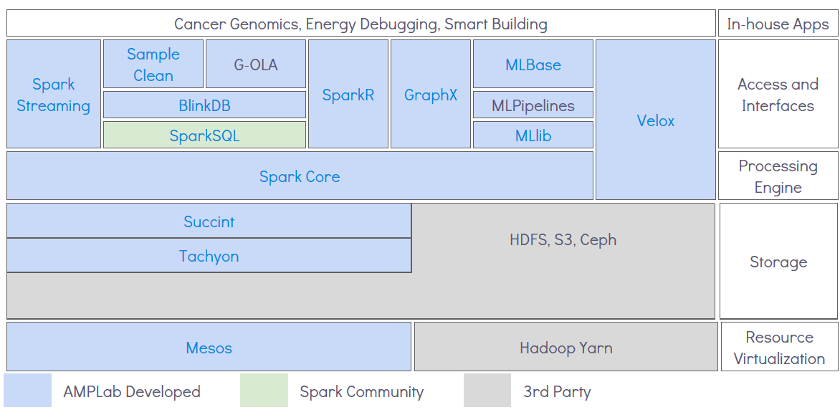
AMPLab’s Berkeley Data Analytics Stack (BDAS)
Don’t need to memorize this figure – the point is to know
that components can be combined to solve big data problems

Slide 60
Apache Spark: Libraries “on top” of core that come with it
Spark SQL
Spark Streaming – stream processing of live datastreams
MLlib - machine learning
GraphX – graph manipulation

Slide 61
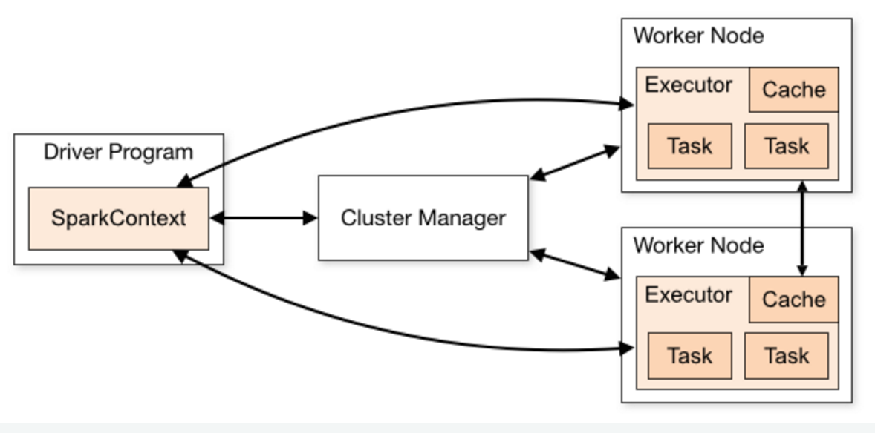

Slide 62
RDD (Resilient Distributed Data )

Slide 63
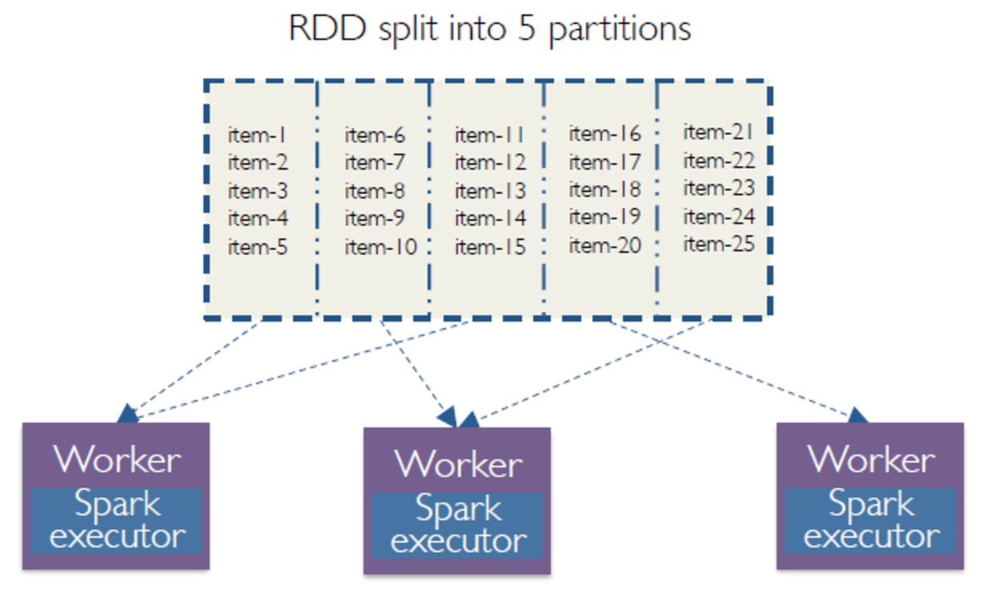
RDD overview

Slide 64
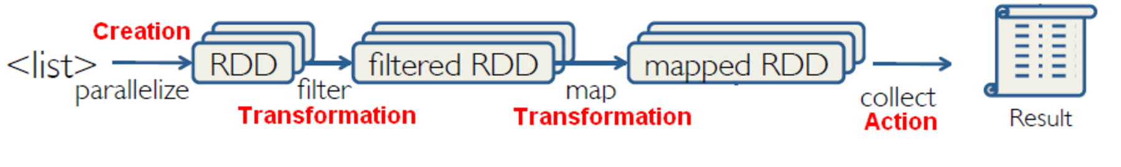
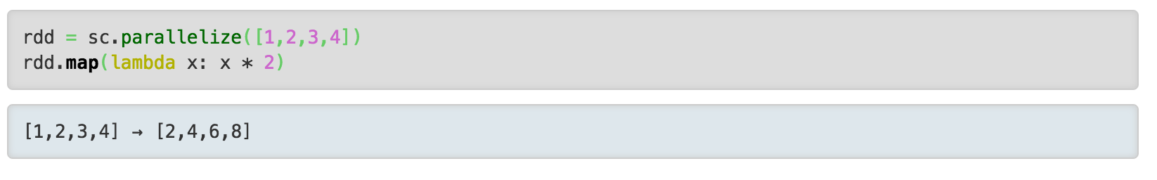
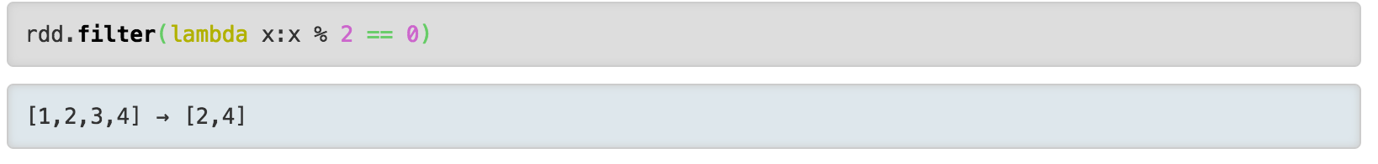
RDD, Transformation, Action
http://spark.apache.org/docs/1.1.1/api/python/pyspark.rdd.RDD-class.html

Slide 65
Sample Spark transformations
map(func): Return a new distributed dataset formed by passing each element of the source through a function func.
filter(func): Return a new dataset formed by selecting those elements of the source on which func returns true
union(otherDataset): Return a new dataset that contains the union of the elements in the source dataset and the argument.
intersection(otherDataset): Return a new RDD that contains the intersection of elements in the source dataset and the argument.
distinct([numTasks])): Return a new dataset that contains the distinct elements of the source dataset
join(otherDataset, [numTasks]): When called on datasets of type (K, V) and (K, W), returns a dataset of (K, (V, W)) pairs with all pairs of elements for each key. Outer joins are supported through leftOuterJoin, rightOuterJoin, and fullOuterJoin.

Slide 66
Sample Spark Actions
reduce(func): Aggregate the elements of the dataset using a function func (which takes two arguments and returns one). The function should be commutative and associative so that it can be computed correctly in parallel.
collect(): Return all the elements of the dataset as an array at the driver program. This is usually useful after a filter or other operation that returns a sufficiently small subset of the data.
count(): Return the number of elements in the dataset.
Remember: Actions cause calculations to be performed;
transformations just set things up (lazy evaluation)

Slide 67
Filter
Map

Slide 68
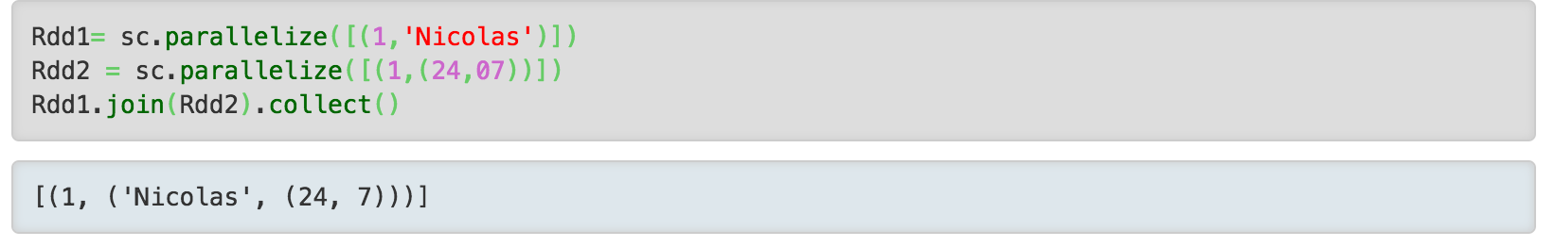
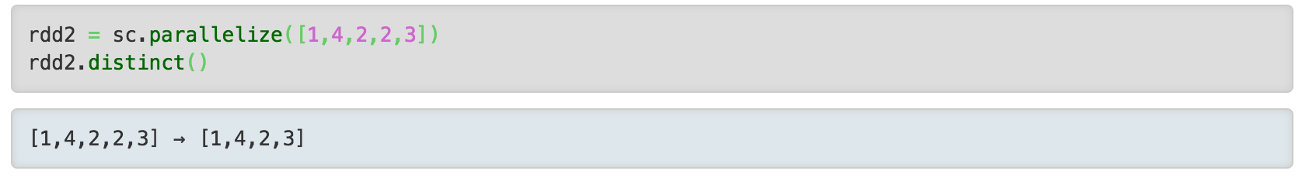
Distinct
Join

Slide 69
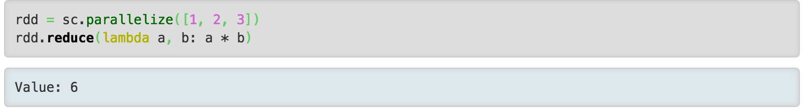
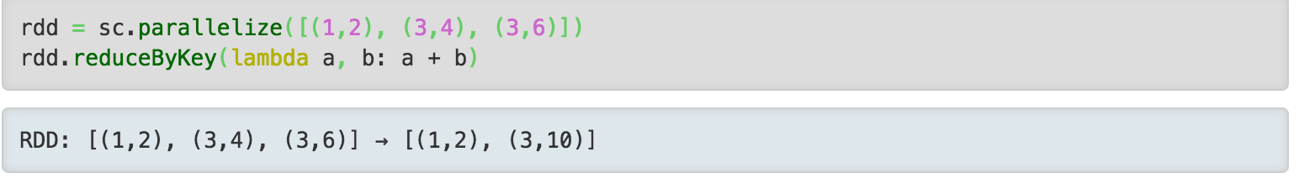
Reduce
ReducebyKey
http://gerardnico.com/wiki/spark/collect

Slide 70
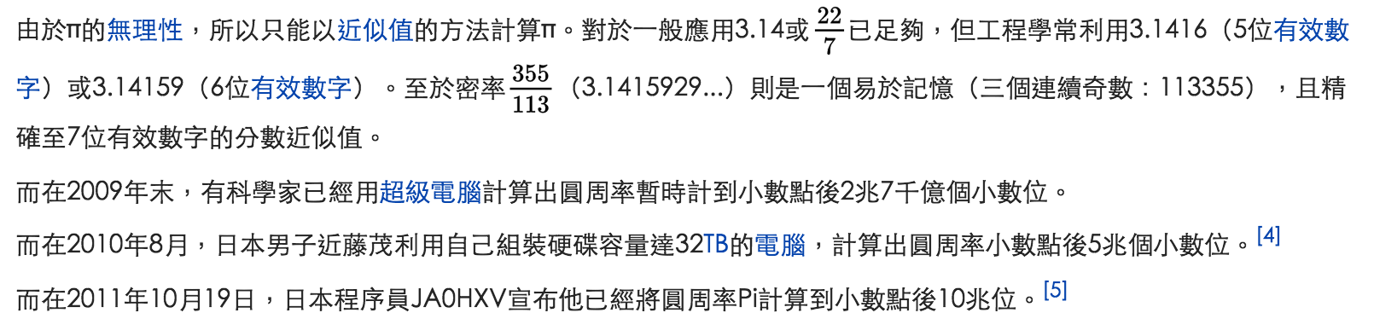
Pi Estimators

Slide 71
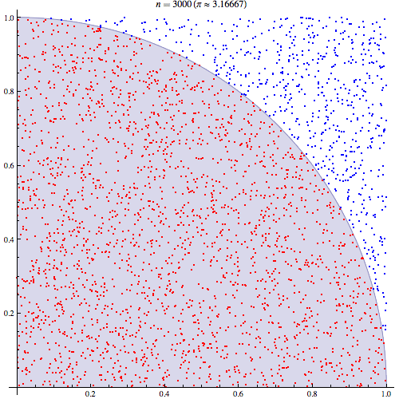

Pi Estimators

Slide 72
Spark example #1 (Python)
# Estimate π (compute-intensive task).
# Pick random points in the unit square ((0, 0) to (1,1)),
# See how many fall in the unit circle. The fraction should be π / 4
# Note that “parallelize” method creates an RDD
def sample(p):
x, y = random(), random()
return 1 if x*x + y*y < 1 else 0
count = spark.parallelize(xrange(0, NUM_SAMPLES)).map(sample) \
.reduce(lambda a, b: a + b)
print "Pi is roughly %f" % (4.0 * count / NUM_SAMPLES)

Slide 73
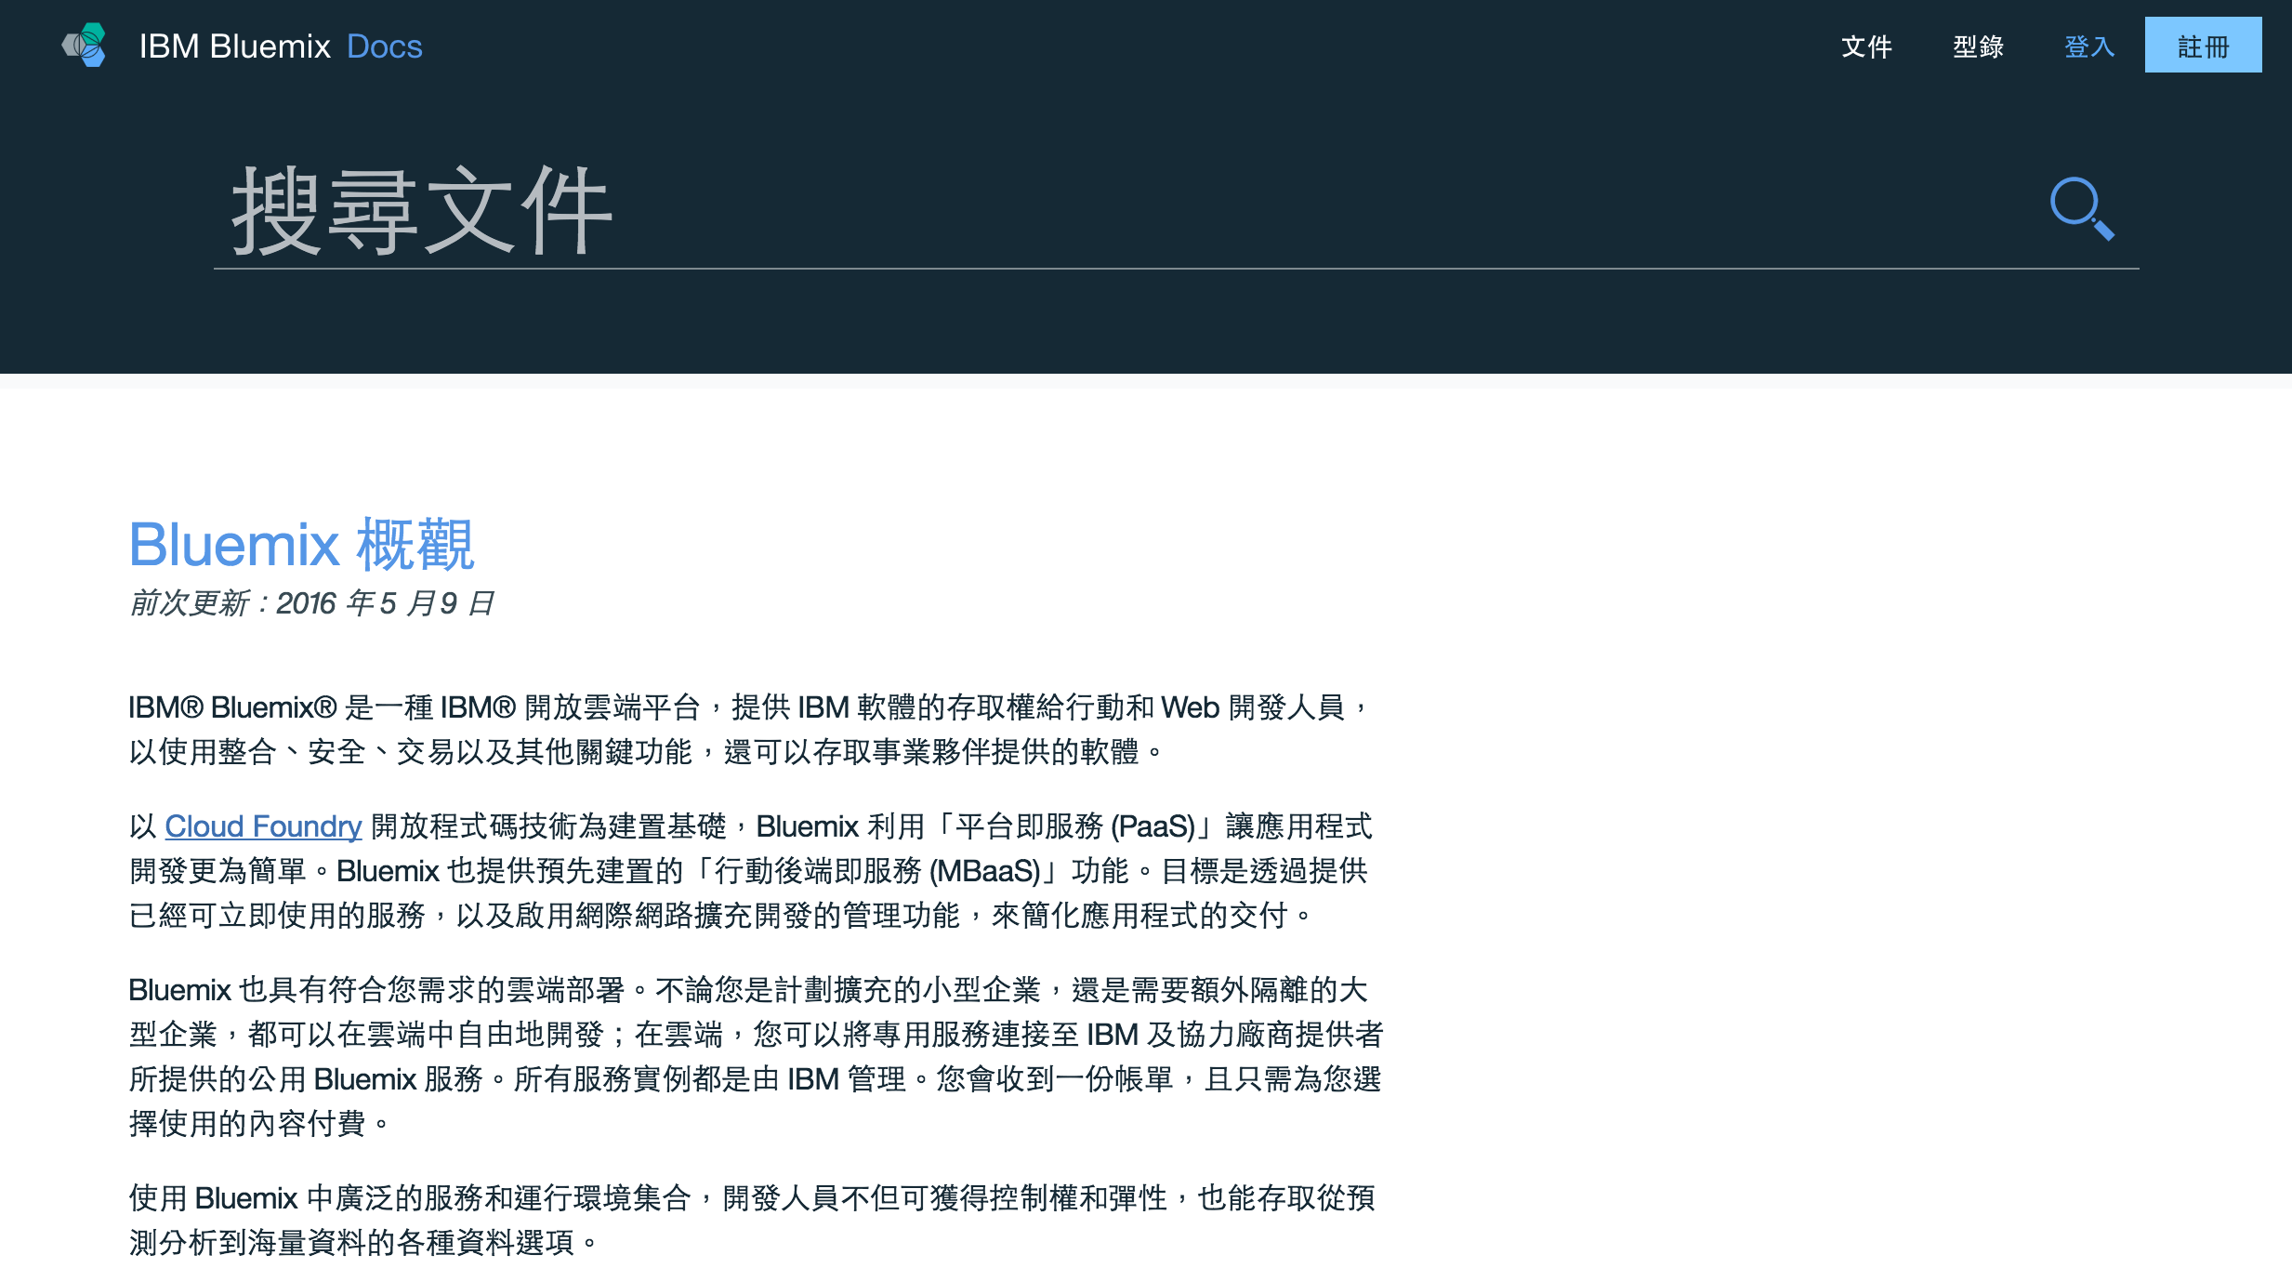
Bluemix

Slide 74
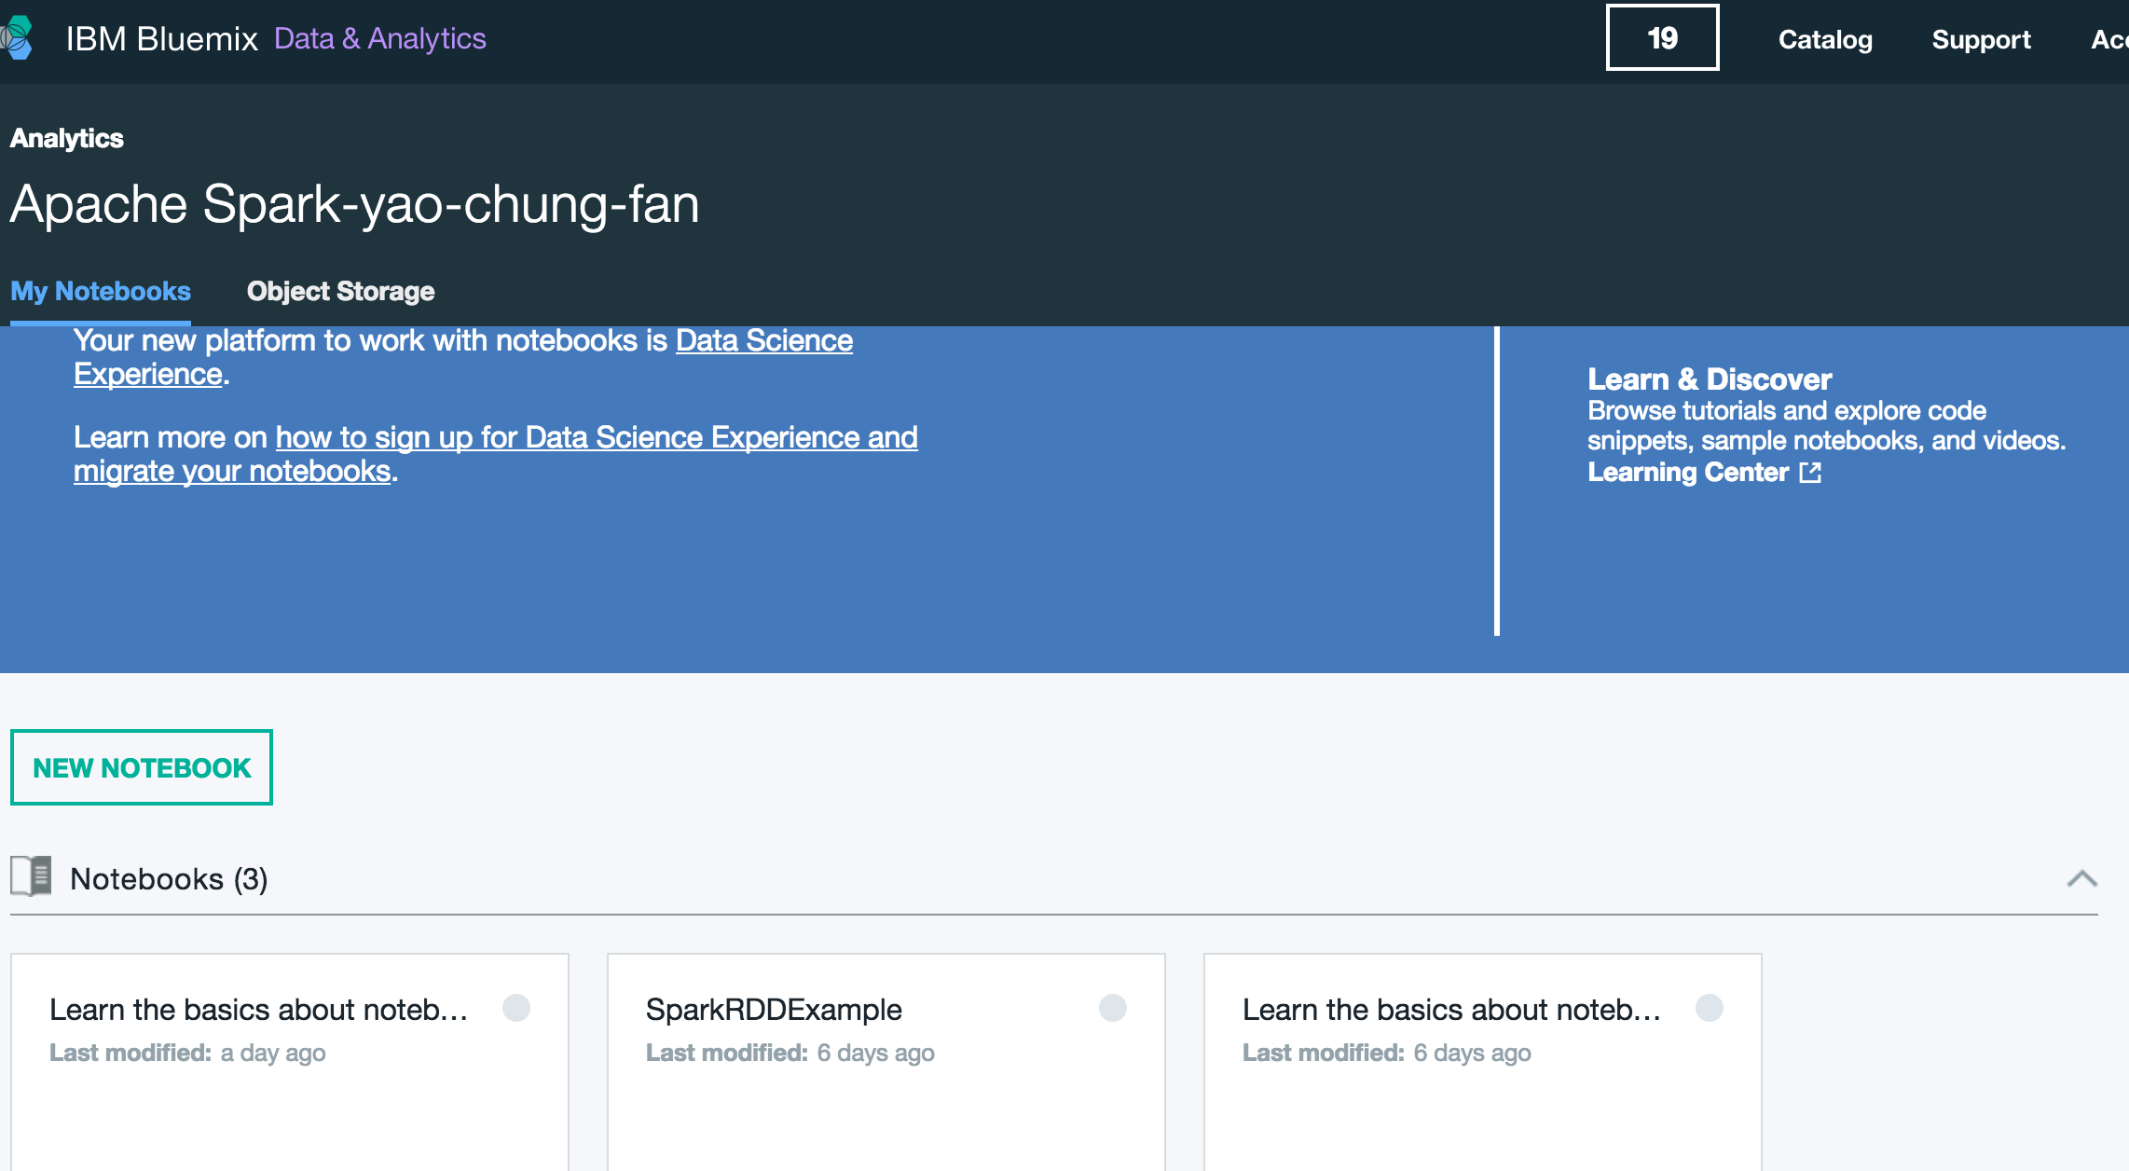
Bluemix Spark

